Slide 1
The Battle of Neighbourhoods - Chennai
Author: Manasa Krishnan
Date : July 22, 2021

Slide 2
Agenda
Introduction
Problem Statement
Data Acquisition
Methodology
Results
Conclusion and Future Works

Slide 3
IntRoduction
Chennai, the city of multiple cultures, is the economic capital of the state of Tamil Nadu located in India. Known for its welcoming nature to citizens of other countries, it is no surprise that restaurants and food outlets play a major role.
Spread across a huge land area, with beautiful beaches, one cannot resist visiting this place. With this project, one would know what to look for exactly, ranging from restaurants to food trucks, and enjoy as a tourist, or better a Chennaite!.
Business People and young entrepreneurs will find this project especially helpful as it will lead to specific locations where their start-ups might become a hit.

Slide 4
Problem Statement
The main aim of the project is to identify several venue categories using latitude and longitude values of the areas of Chennai and merge it with the Foursquare API so that business-minded people and even the Chennaites can make use of the clustered data to make smart decisions about starting a business in a given location depending on its popularity.
The target audience are the business people and young entrepreneurs who want to start their businesses in and around Chennai.

Slide 5
Data acquisition
The link to dataset used here is: https://chennaiiq.com/chennai/latitude_longitude_areas.asp . The .csv file consists of columns named Neighborhood, Latitude and Longitude. The data for venues across the areas of Chennai will be obtained later with the Foursquare API credentials, Client ID and Client Secret.
After sucessfully importing all the necessary libraries, we go ahead with extracting necessary information from the html page using soap object and html parser. We collect only the location, latitude and longitude information, convert it into a dataframe, rename the columns and finally get the resulting dataframe with column names Neighbourhood, Latitude and Longitude.

Slide 6
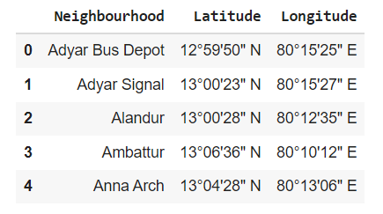
Data acqusition

Slide 7
methodology
Step 1: We will find the latitude and longitude values of Chennai and visualise the areas given in the dataset using Folium and Geopy libraries.
Step 2: we use our Foursquare credentials to extract popular venues in and around the areas of Chennai. We use our Client ID and Client Secret to access our Foursquare account and find the venue names. We convert all these details into a dataframe understandable by all the users.
Step 3: We use the groupby method to find the unique number of venue categories from the dataset that we derive after using Foursquare API to get the venue category, latitude and longitude of the areas of Chennai. We get a total of 141 unique venue categories.

Slide 8
Methodology
Step 4: With matplolib library’s easy-to-use interface, we will plot a bar chart for the venue categories at hand to check for bias.
Step 5: One-hot encoding is applied to Venue Category as cluster analysis will be performed based on those categories.
Step 6: With K-Means algorithm, we can finally visualise Chennai city's map with superimposed markers. First, we identify the appropriate number of clusters needed for our problem at hand. For that, we use silhouette score from sklearn.metrics package. We will produce a dataframe with each neigbourhood’s first to tenth most common venues. These venues range from restaurants, multiplex, electronic stores, shopping malls, bus stations, grocery stores etc.

Slide 9
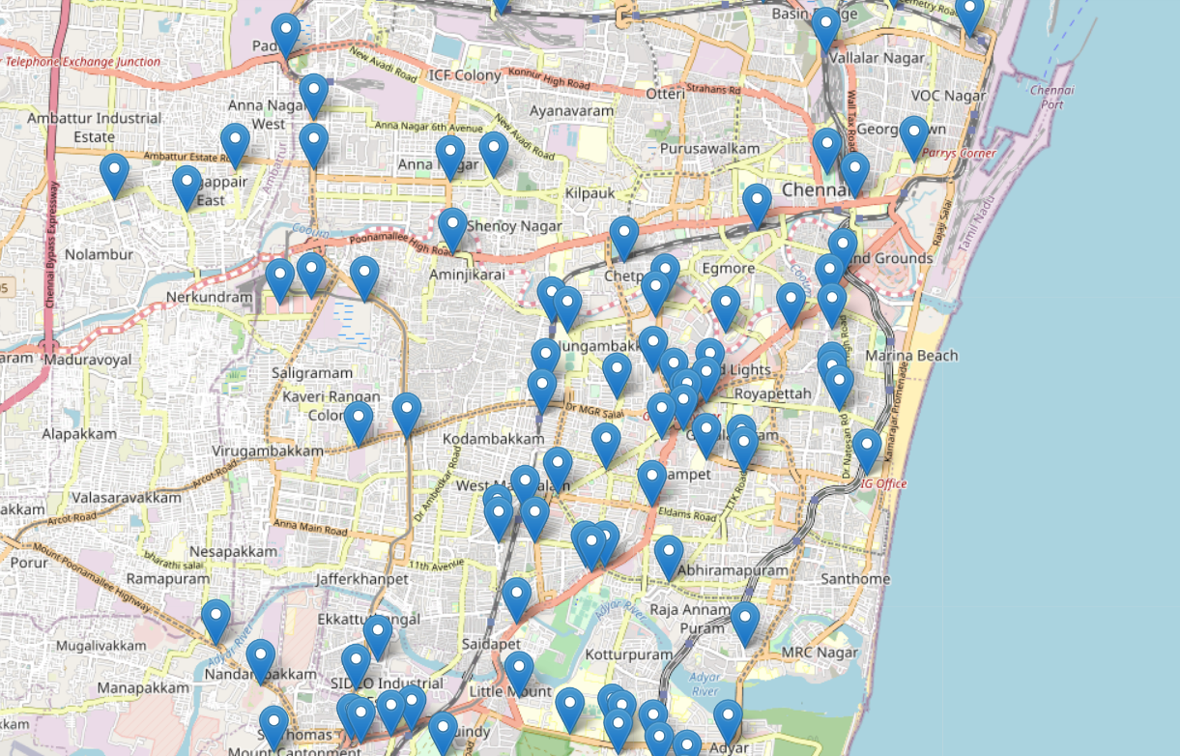
Results
The areas of Chennai visualised using geopy and folium library plotted using marker cluster algorithm

Slide 10
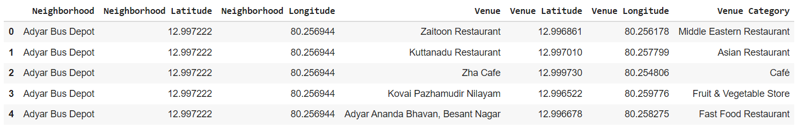
Results
The venue details obtained for areas of Chennai using Foursquare API

Slide 11
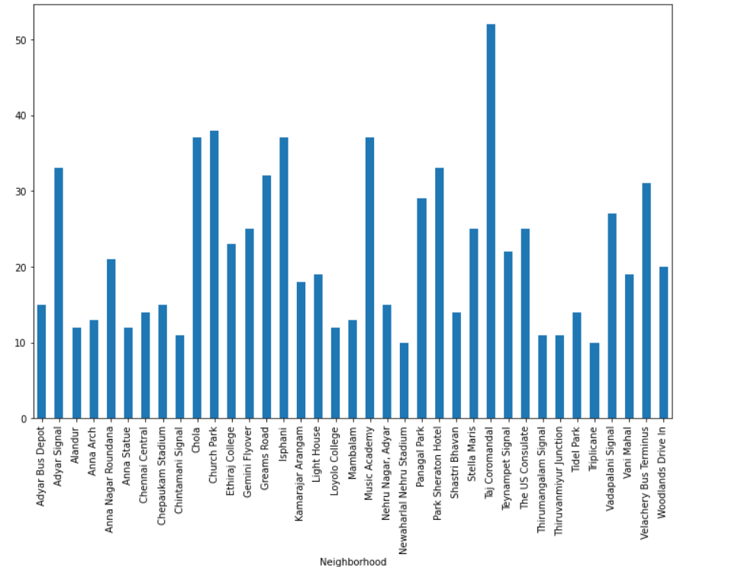
Results
A bar chart after removing bias showing the venues which are equal to or more than 10 in number

Slide 12
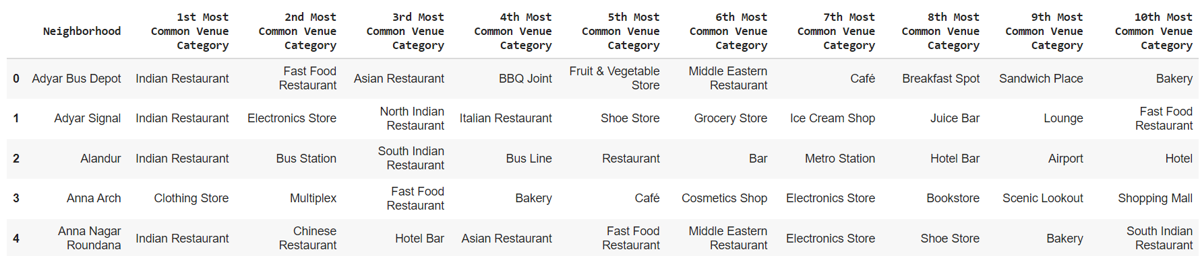
Results
A dataframe consisting of the top 10 venue categories for each area of Chennai

Slide 13
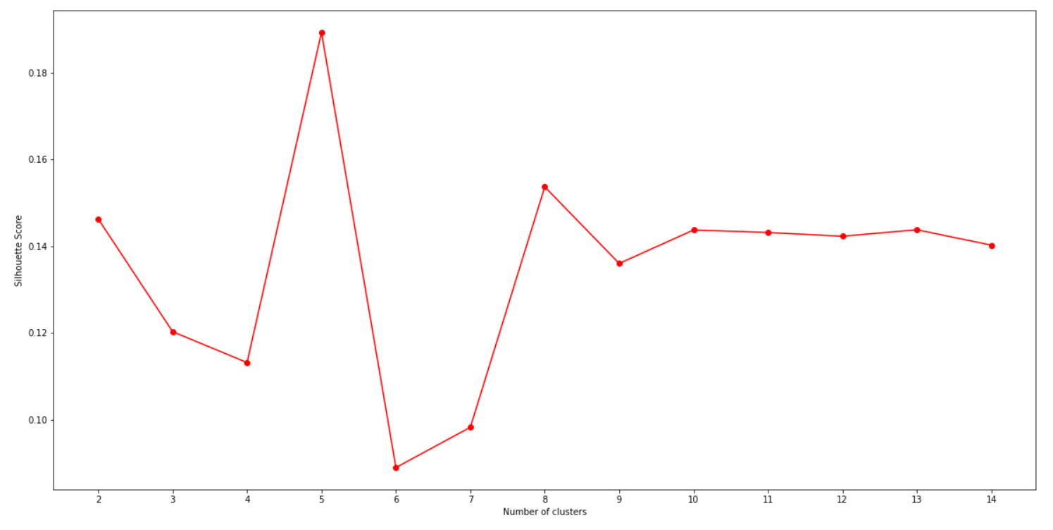
Results
The optimised number of clusters is found to be 5 using silhouette score

Slide 14
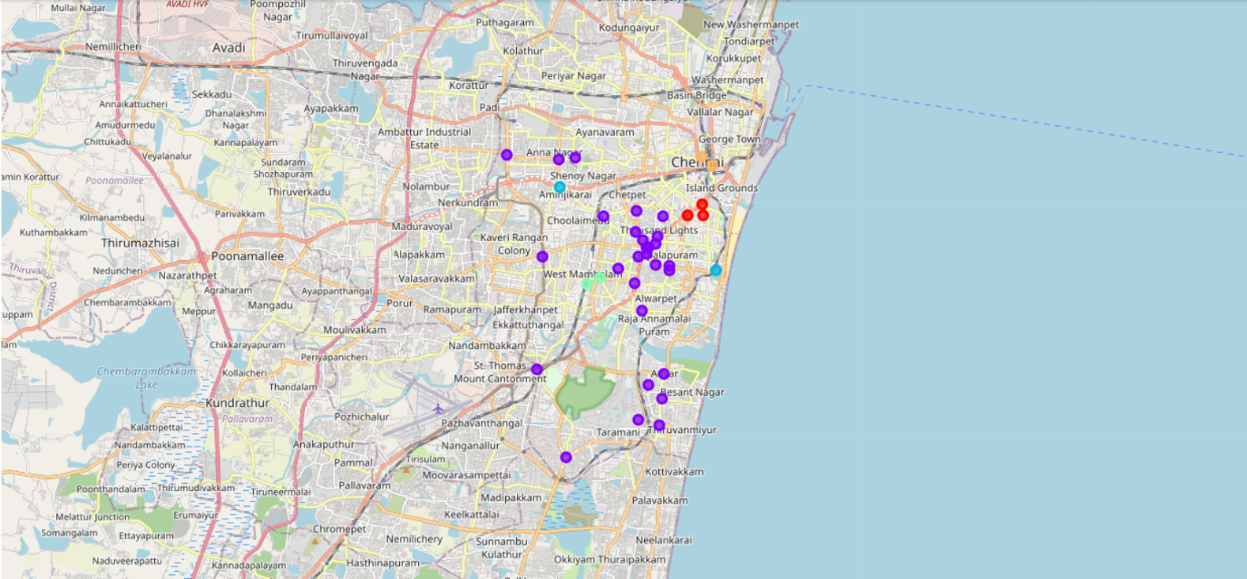
Results
Clustering is done on leaflet map using Folium and geopy. Circle markers are used to mark the areas within each cluster. There are a total of 5 clusters

Slide 15
Conclusion and future works
This project is successful in deriving clusters of venue categories onto the Leaflet maps which can be used by stakeholders to decide and analyse what kind of business becomes a hit in certain locations.
This will inevidently be useful for both common people and stakeholders as it is visualised in the form of a dataframe (i.e) a table which is user-friendly.
As days go on, several startups lay their foot on Chennai and so the dataset must be updated regularly. With this dataset, not only more kind of maps can be coded but also with the help of tools such as "R" and "Matlab", one can also make interactive visualisations of the information at hand so it is pleasing to our eyes. A dashboard can be coded with inputs such as area, latitude and longitude and outputs as venue categories.

